Slide 1
PIP4004 - INTERNSHIP Review-1 Presentation VAJRA AND ODIN CRAWLER
Student Details
Name | Manur Yashas Sreevatsa
Roll No | 20211CSE0275
Section | 8CSE11
Batch No. | 72
Under the Supervision of,
Dr. Bhavana A
Assistant Professor Selection Grade
School of Computer Science and Engineering
Presidency University
Name of the Program: B.Tech
Name of the HoD: Mohammed Asif T
Name of the Program Project Coordinator: Mr. Jerrin Joe Francis
Name of the School Internship/Project Coordinators: Mr. Md Ziaur Rahman

Slide 2
Content
Title
Abstract
Review of literature
Objectives
Problem identification, and formulation of problem statement
Road map, impact and advantages of the proposed work
References
GitHub Link

Slide 3
Title: Vajra - Intelligent IXP Traffic Management
Vajra is a network optimization and cybersecurity solution developed by Astraeus Next Gen Pvt. Ltd.
Focuses on collecting Internet Exchange Point (IXP) data and rerouting network traffic for better performance and security.

Slide 4
Title: Odin Crawler
Odin Crawler is a subscription-based web crawler tool that allows users to extract targeted information from the internet with controlled access.
It features a PayPal integration, free trial period, and usage limits, ensuring secure access while displaying only a limited number of links per query for efficient data handling.

Slide 5
Abstract
Vajra is an intelligent IXP traffic monitoring and rerouting system that optimizes data flow across internet exchange points (IXPs). It dynamically detects high traffic and congestion and reroutes data through alternative paths, ensuring efficient data transfer. The system leverages network topology analysis, automated rerouting mechanisms, and real-time monitoring for enhanced performance and reduced latency.
Odin Crawler is a smart, subscription-based web crawling system designed to extract targeted data efficiently from the internet. It enables users to input keywords and retrieve a limited set of relevant links, ensuring focused and lightweight data access. Integrated with PayPal, the system offers a secure 3-day free trial followed by a subscription model. Odin leverages controlled crawling mechanisms, usage caps, and real-time filtering to ensure responsible data collection, minimize server load, and support scalable information retrieval.

Slide 6
Review of literature (Vajra)
Dijkstra’s Algorithm (Dijkstra, 1959):Used for finding the shortest path in network routing, ensuring optimal traffic flow through IXPs by selecting the least congested paths dynamically.
Bellman-Ford Algorithm (Bellman, 1958):Useful for handling networks with dynamic link changes, allowing rerouting decisions even with negative weight cycles.
Floyd-Warshall Algorithm (Floyd, 1962):Helps compute shortest paths between all pairs of nodes in a network, ensuring efficient global traffic balancing across IXPs.
Border Gateway Protocol (BGP) (RFC 4271):A fundamental protocol for routing between different autonomous systems, ensuring robust and scalable traffic management.

Slide 7
Review of literature (Odin Crawler)
Scrapy (An Open-Source Web Crawling Framework):A powerful Python-based framework used for extracting data from websites. It supports asynchronous processing and is highly customizable, making it suitable for building scalable and efficient crawling systems like Odin Crawler.
BeautifulSoup (Python Library for Web Scraping):Provides simple tools for navigating and parsing HTML and XML documents. It is often used in conjunction with crawling frameworks to clean and structure raw web data effectively.
Common Crawl (Open Repository of Web Crawl Data):An open-access dataset containing petabytes of web crawl data. It serves as a reference for understanding large-scale web scraping techniques, keyword indexing, and efficient link extraction models.

Slide 8
Objectives (Vajra)
Develop a dynamic traffic rerouting system to balance IXP load efficiently: Implement an intelligent routing mechanism that continuously monitors IXP traffic and dynamically redistributes network load to prevent congestion.
Minimize congestion at major IXPs and optimize latency and throughput: Reduce bottlenecks at heavily utilized IXPs by directing traffic through alternative lower-latency routes, ensuring smoother and faster data transmission.
Automate traffic monitoring and rerouting using real-time network analysis: Utilize live packet capture and network analytics to detect traffic spikes instantly and trigger automated rerouting decisions for optimal network performance.
Integrate scalable caching and historical traffic analysis for predictive routing: Store and analyze past traffic patterns to anticipate future congestion trends, enabling proactive rerouting before bottlenecks occur.

Slide 9
Objectives (Odin Crawler)
To develop a secure, subscription-based web crawling system that enables controlled access to web data using PayPal integration and a free trial model.
To implement keyword-based data extraction that displays a limited number of relevant links per query for efficient and focused data retrieval.
To enforce usage limits and crawling constraints that prevent server overload and promote responsible, ethical data collection.
To ensure scalability and performance by integrating asynchronous crawling methods and lightweight parsing mechanisms.
To provide a user-friendly interface for initiating crawls, managing subscriptions, and viewing results with ease.

Slide 10
Problem identification, and formulation of problem statement (Vajra)
Problem Statement:
Due to increasing internet traffic, major IXPs experience congestion, leading to higher latency and data loss. Vajra aims to intelligently monitor and reroute traffic through alternate IXPs to optimize performance.
Key Challenges:
High-traffic IXPs reduce overall data transfer speeds.
Lack of real-time rerouting mechanisms in traditional traffic management.
Inability to dynamically analyze and predict traffic congestion.
Inefficient handling of IXP topology changes.

Slide 11
Problem identification, and formulation of problem statement (Odin Crawler)
Problem Statement:
In the age of information overload, users and organizations often struggle to extract relevant web data efficiently and securely. Traditional web crawlers either lack user control, pose ethical risks, or are not scalable.
Key Challenges:
High-traffic IXPs reduce overall data transfer speeds, leading to performance bottlenecks for ISPs and users.
Lack of real-time rerouting mechanisms in traditional network management systems prevents timely traffic redistribution.
Inability to dynamically analyze and predict traffic congestion, resulting in reactive rather than proactive traffic control.

Slide 12
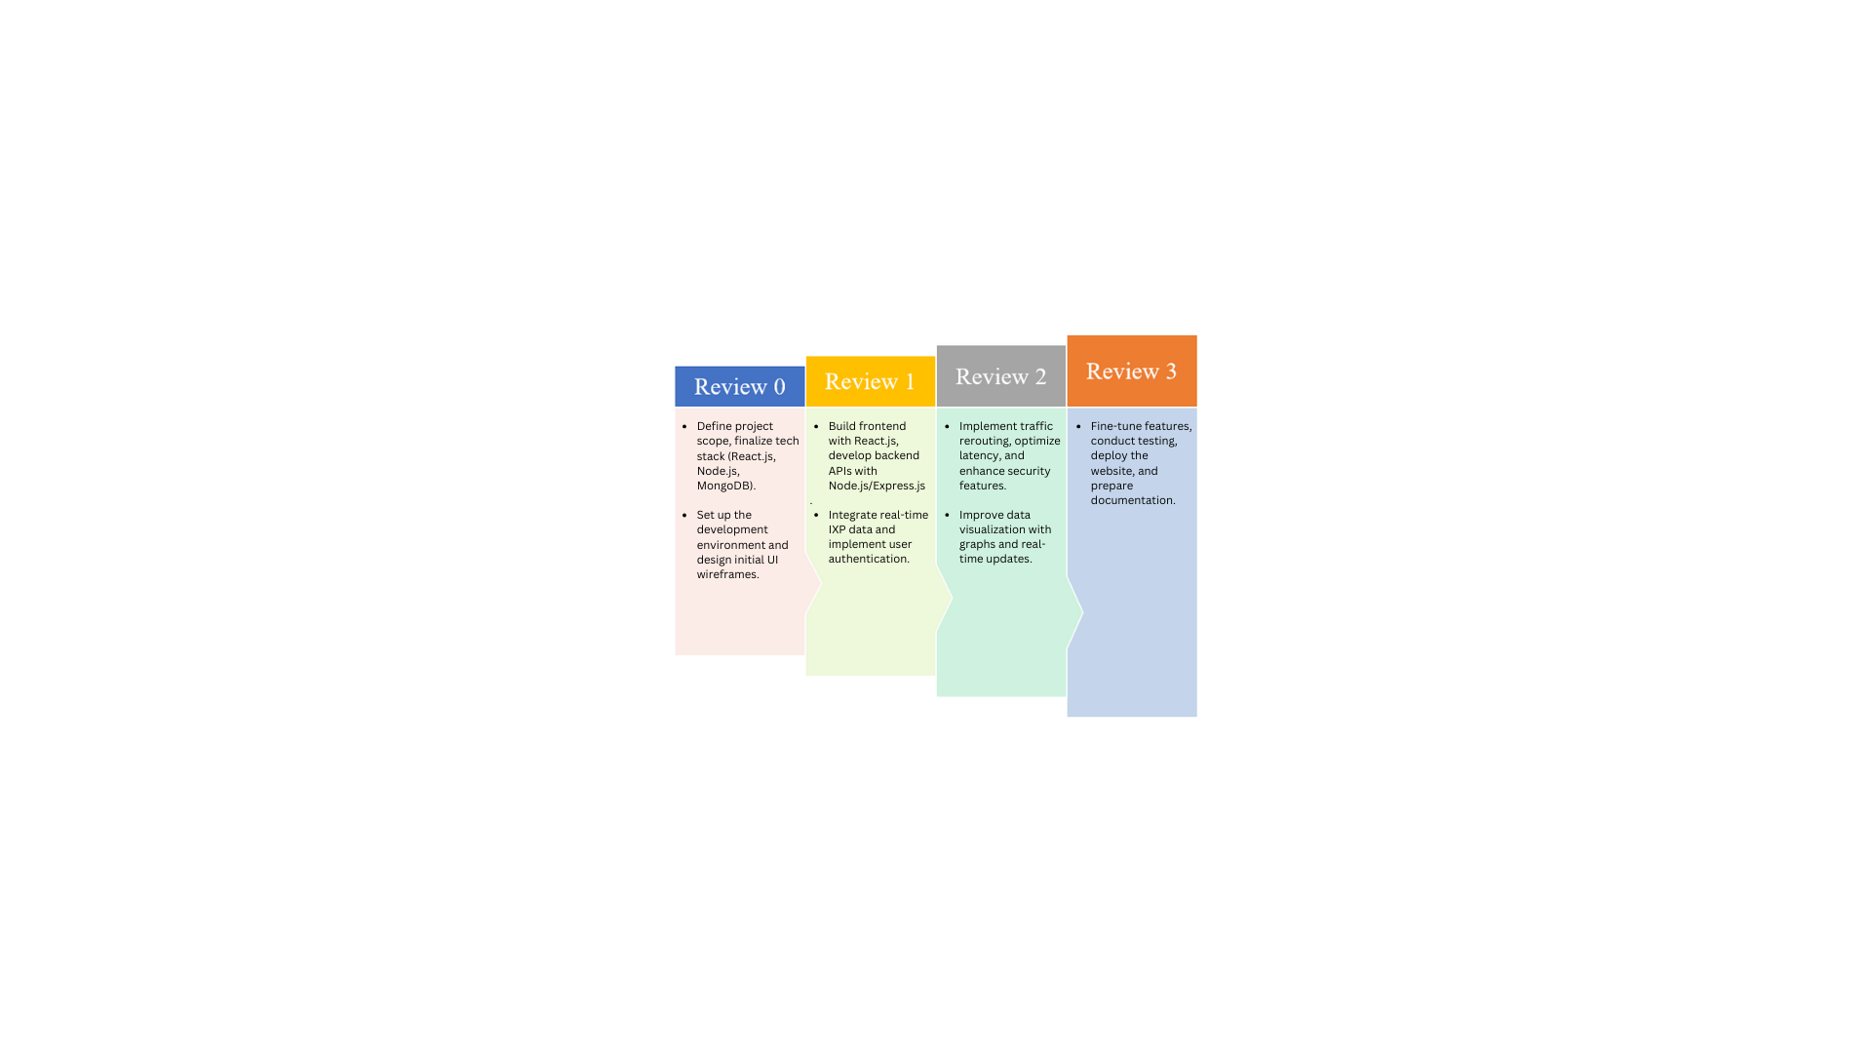
Road map, impact and advantages of the proposed work (Vajra)

Slide 13
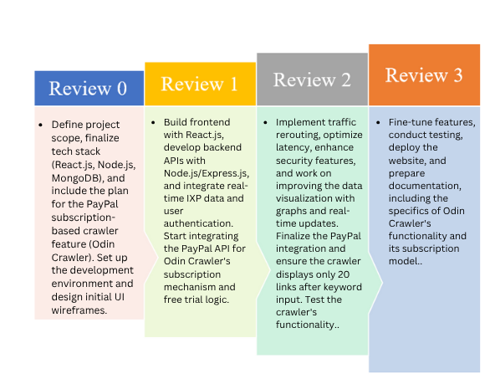
Road map, impact and advantages of the proposed work (Odin Crawler)

Slide 14
References
Dijkstra, E. W. (1959). A Note on Two Problems in Connexion with Graphs. This paper introduces Dijkstra’s algorithm, a shortest path algorithm used in network routing and traffic optimization. It helps find the most efficient path between IXPs while considering congestion.
Bellman, R. (1958). On a Routing Problem.Bellman-Ford’s algorithm is crucial for dynamic routing as it can handle negative weights and fluctuating network conditions. It ensures efficient path selection while preventing loops and congestion.
PeeringDB API Documentation. (https://www.peeringdb.com/apidocs/) PeeringDB is a public database that provides real-time information about IXPs, ISPs, and data centers. The API is used to fetch up-to-date IXP topology and traffic data to enhance decision-making.

Slide 15
References(contd)
Euro-IX Database Documentation. (https://ixpdb.euro-ix.net/en/) The Euro-IX database contains global IXP information, including connectivity, bandwidth capacity, and locations. It helps in mapping IXP traffic flow and selecting optimal rerouting paths.
NetworkX Python Library Documentation. (https://networkx.org/) NetworkX is a Python library used for creating and analyzing network graphs. It enables modeling IXP topology, finding alternative routes, and analyzing traffic patterns dynamically.
Dhaka, V. S., & Singh, S. K. (2013). A review of web crawling strategies, comparing breadth-first, depth-first, and focused crawlers. This study informed Odin’s lightweight, keyword-targeted crawling strategy. https://www.researchgate.net/publication/258789938_Web_Crawler_A_Review

Slide 16
References(contd)
Dhaka, V. S., & Singh, S. K. (2013). A review of web crawling strategies, comparing breadth-first, depth-first, and focused crawlers. This study informed Odin’s lightweight, keyword-targeted crawling strategy. https://www.researchgate.net/publication/258789938_Web_Crawler_A_Review
Sharma, A. K., et al. (2020). Analyzes crawling performance using multi-threaded and asynchronous methods. Odin adopted async crawling to maximize speed and efficiency in page retrieval. https://www.sciencedirect.com/science/article/abs/pii/S2214785320351440
Busa-Fekete, R., et al. (2024). Explores adaptive crawling using external change signals. While Odin doesn’t yet implement this, it offers a future path for real-time crawl prioritization. https://arxiv.org/abs/2502.02430

Slide 17
References(contd)
Nandy, S., et al. (2012). Proposes statistical learning mechanisms to increase crawl speed, which guided Odin’s selective crawling mechanism that avoids redundant page visits. https://arxiv.org/abs/1208.2808
Chakrabarti, S., et al. (1999). Introduces focused crawling, where search is limited to thematically relevant content. Odin directly incorporates this technique to improve keyword relevance. https://www.sciencedirect.com/science/article/pii/S1389128699000523

Slide 18
GitHub Link
https://github.com/YASHCODE2004/VAJRA_INTERNSHIP-AND-ODIN-CRAWLER

Slide 19
Thank you !!

